Slide 1
Adversarial Multi-Criteria Learning for Chinese Word Segmentation
Xinchi Chen (Fudan University)
Advisors: Prof. Xuanjing Huang
Prof. Xipeng Qiu
Direction: Natural Language Processing

Slide 2

What is Chinese word segmentation (CWS) ?
中国官员应邀到美国开会
中国/官员/应邀/到/美国/开会
大学生活好，还是中学生活好
大学/生活/好，还是/中学/生活/好
如果你饿了，我就下面给你吃
如果/你/饿/了，我/就/下/面/给/你/吃

Slide 3
基于统计的分词
基于词的方法
基于字的序列标注方法¹
基于词和基于字的方法的结合
1. N. Xue. 2003. Chinese word segmentation as character tagging. Computational Linguistics and Chinese Language Processing 8(1):29–48.

Slide 4
基于字的序列标注方法
B E B E S S B E B E B E S
大学/生活/好/，/还是/中学/生活/好

Slide 5
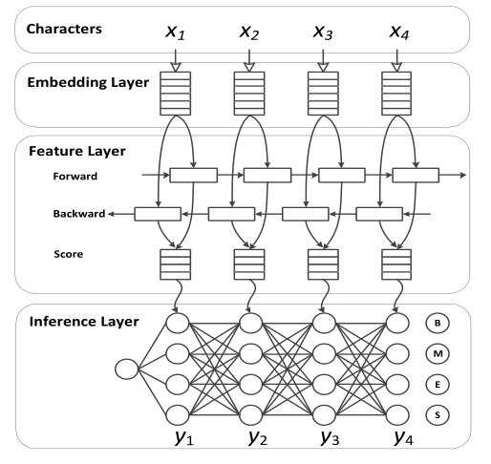
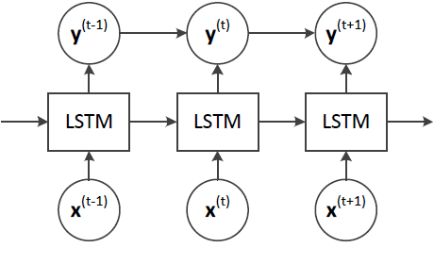
Long Short-term Neural Network based CWS [X Chen, X Qiu, C Zhu, P Liu, X Huang; EMNLP 2015]

Slide 6
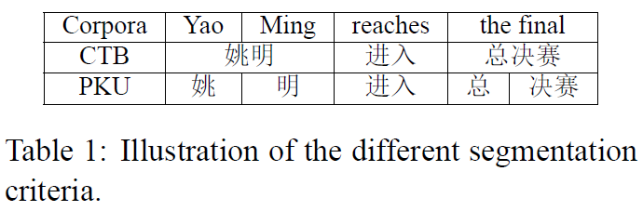
Adversarial Multi-Criteria Learning for Chinese Word Segmentation [X Chen, Zhan Shi, X Qiu, X Huang; ACL 2017]

Slide 7
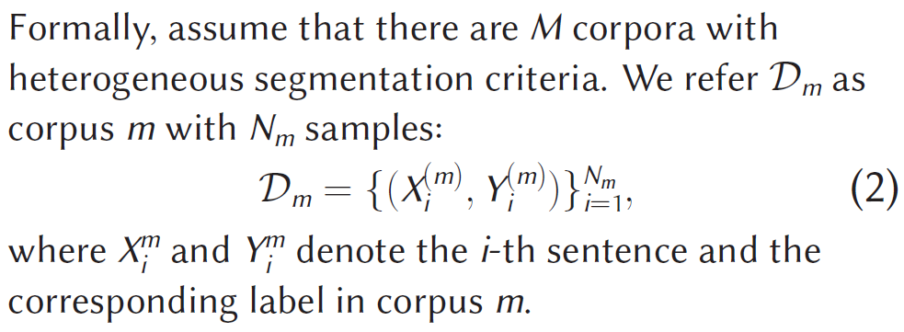
Adversarial Multi-Criteria Learning for Chinese Word Segmentation [X Chen, Zhan Shi, X Qiu, X Huang; ACL 2017]

Slide 8
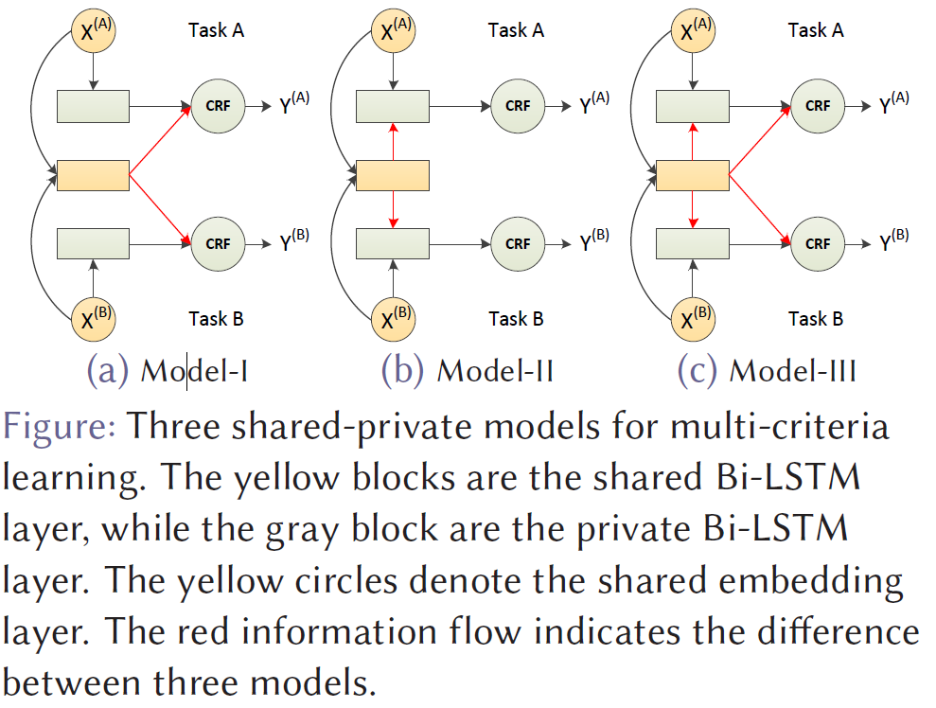
Adversarial Multi-Criteria Learning for Chinese Word Segmentation [X Chen, Zhan Shi, X Qiu, X Huang; ACL 2017]

Slide 9
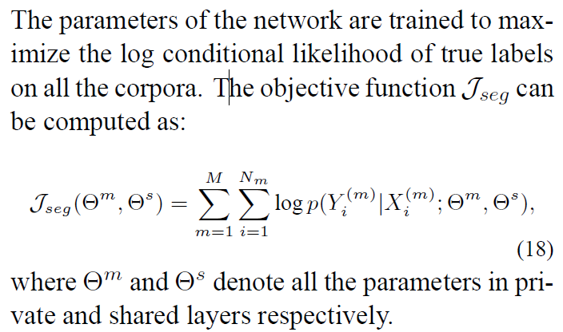
Objective function

Slide 10
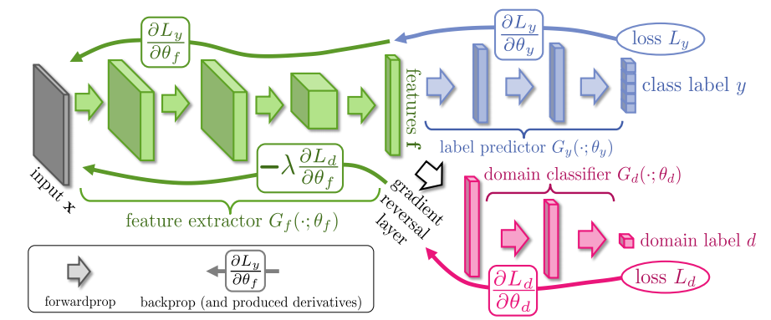
Unsupervised Domain Adaptation by Backpropagation [Yaroslav Ganin, et al.]

Slide 11
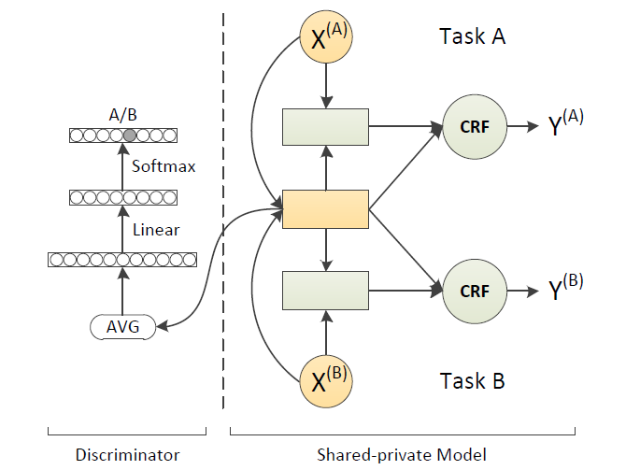
Adversarial Multi-Criteria Learning for Chinese Word Segmentation [X Chen, Zhan Shi, X Qiu, X Huang; ACL 2017]

Slide 12
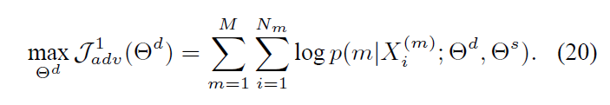

Adversarial loss function
The criterion discriminator maximizes the cross-entropy of predicted criterion distribution p( |X) and true criterion.
An adversarial loss aims to produce shared features, such that a criterion discriminator cannot reliably predict the criterion by using these shared features. Therefore, we maximize the entropy of predicted criterion distribution when training shared parameters.
Notes:
Unlike (Ganin et al., 2016), we use entropy term
instead of negative cross-entropy.

Slide 13
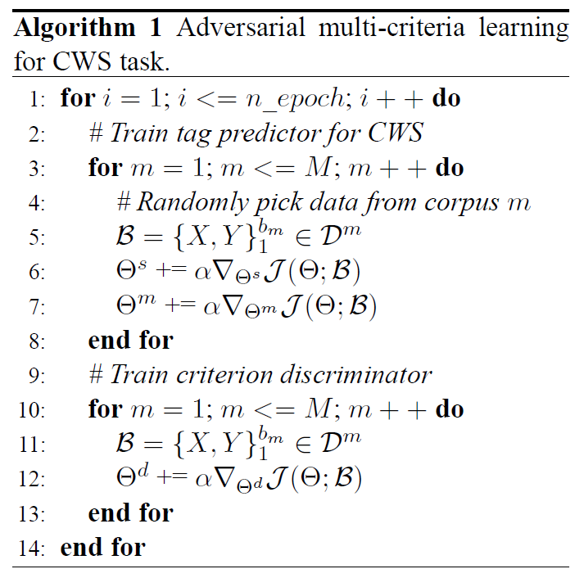
Training

Slide 14
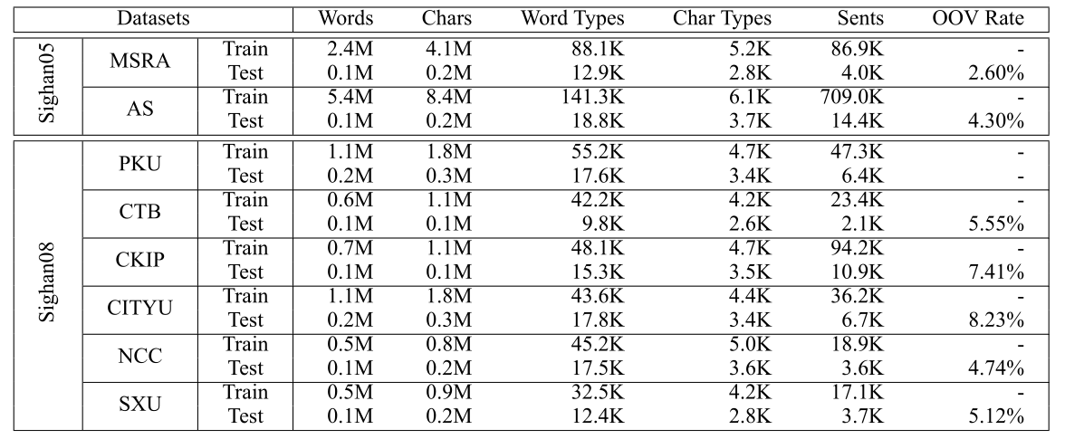
Experiments

Slide 15
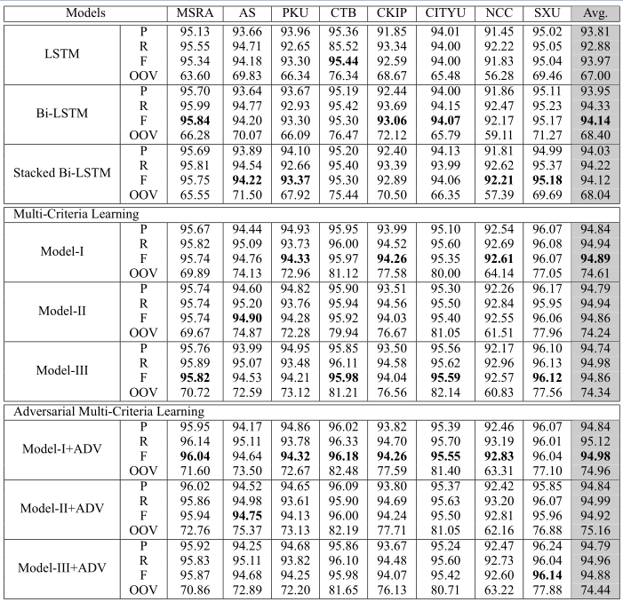
Experiments

Slide 16
Experiments

Slide 17
Experiments

Slide 18
Experiments

Slide 19
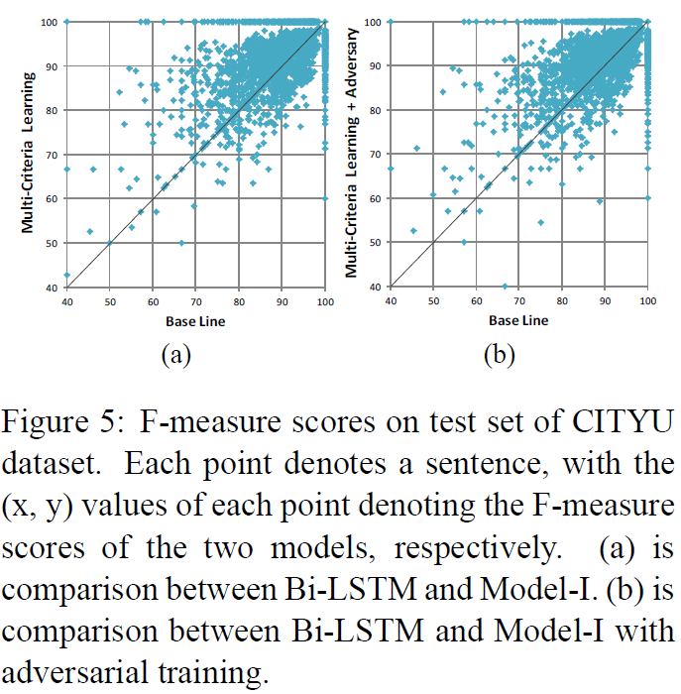
Error Analysis

Slide 20
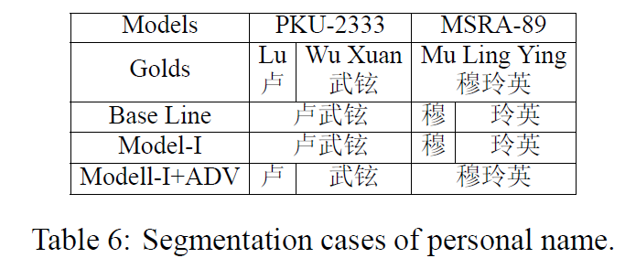
Case Study

Slide 21
Knowledge Transfer
Simplified Chinese to Traditional Chinese
Formal Texts to Informal Texts

Slide 22
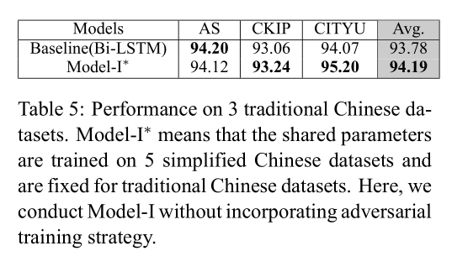
Simplified Chinese to Traditional Chinese

Slide 23
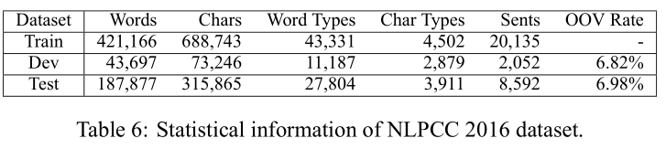
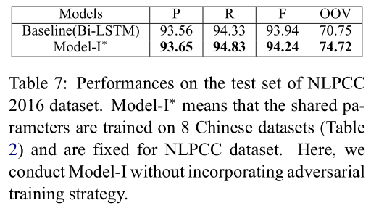
Formal Texts to Informal Texts

Slide 24
Thank you for your attention!
Xinchi Chen (Fudan University)
Advisors: Prof. Xuanjing Huang
Prof. Xipeng Qiu
Direction: Natural Language Processing

